Slide 1


An Enterprise-Grade Serverless Architecture Deployed on AWS
Advanced Decoupling, Fault Tolerance, and Controlled Elasticity
Cloud Computing Technologies - Final Project | Calloni Matteo

Slide 2
Objectives & Addressing Previous Feedback
Controlled Scaling: Moving from AWS default unbounded scaling to explicit architectural limits to protect downstream databases.
Application-Level Resilience: Implementing explicit Fault Tolerance mechanisms (DLQ) to handle corrupted data.
Enhanced Compute Logic: Implementing real business logic in Lambda instead of simple metadata extraction.
Strict Security: Demonstrating Least Privilege application through custom IAM policies rather than managed ones.

Slide 3
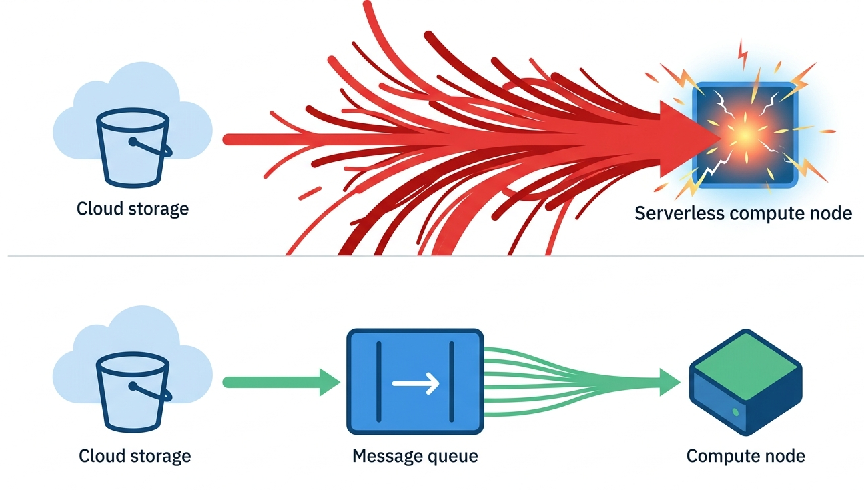
The Problem: Direct Integration vs. Decoupling
Initial Approach: S3 directly triggering Lambda.
The Problem: Sudden traffic spikes cause Lambda to scale uncontrollably (up to 1,000 instances), risking "Throttling Exceptions" on DynamoDB.
The Solution: Introducing the Queue-Based Load Leveling pattern using Amazon SQS as a shock absorber.

Slide 4

The Advanced Decoupled Architecture
Ingestion: Amazon S3 sends Event Notifications to a central SQS Queue.
Buffer: SQS holds messages, fully decoupling storage from compute.
Compute: AWS Lambda pulls messages asynchronously.
Persistence: DynamoDB securely stores enriched telemetry data.

Slide 5
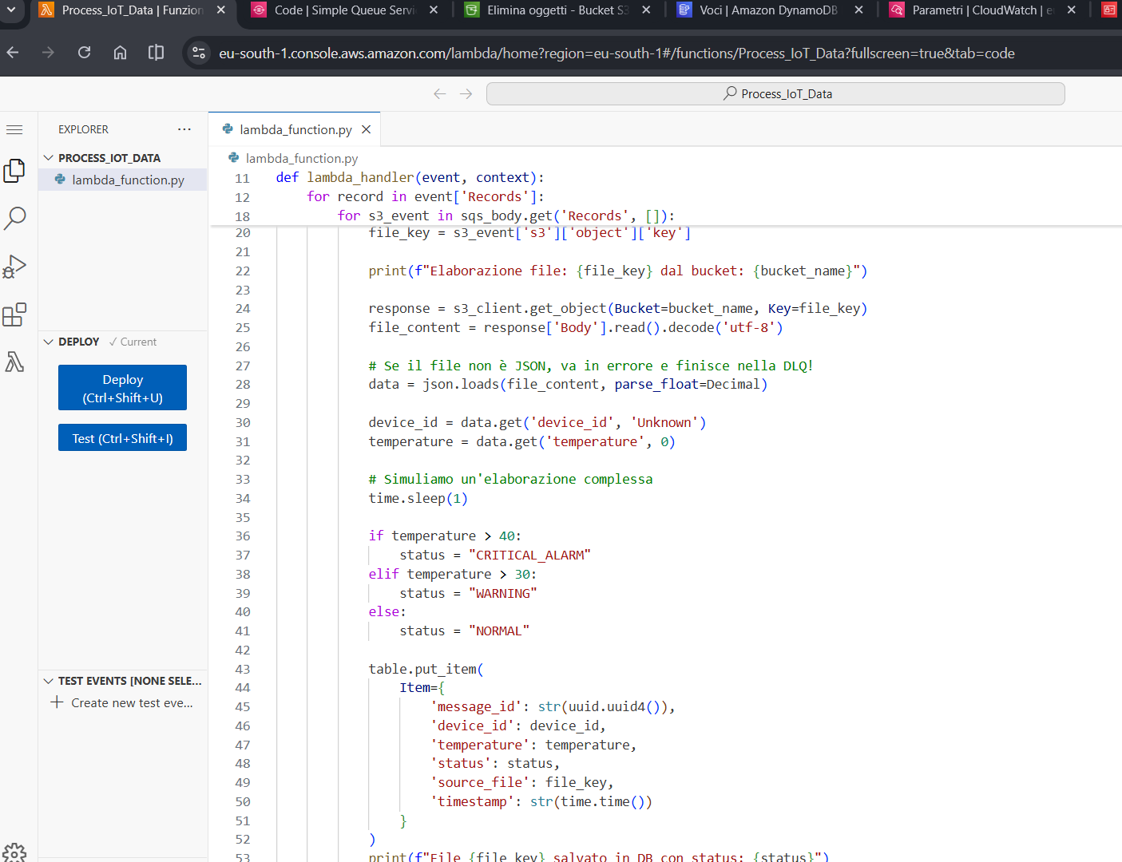
Stateless Compute & Business Logic
Lambda dynamically evaluates the payload.
Downloads the actual JSON file from S3 via boto3.
Evaluates the temperature parameter against predefined thresholds.
Classifies data into NORMAL, WARNING, or CRITICAL_ALARM.

Slide 6
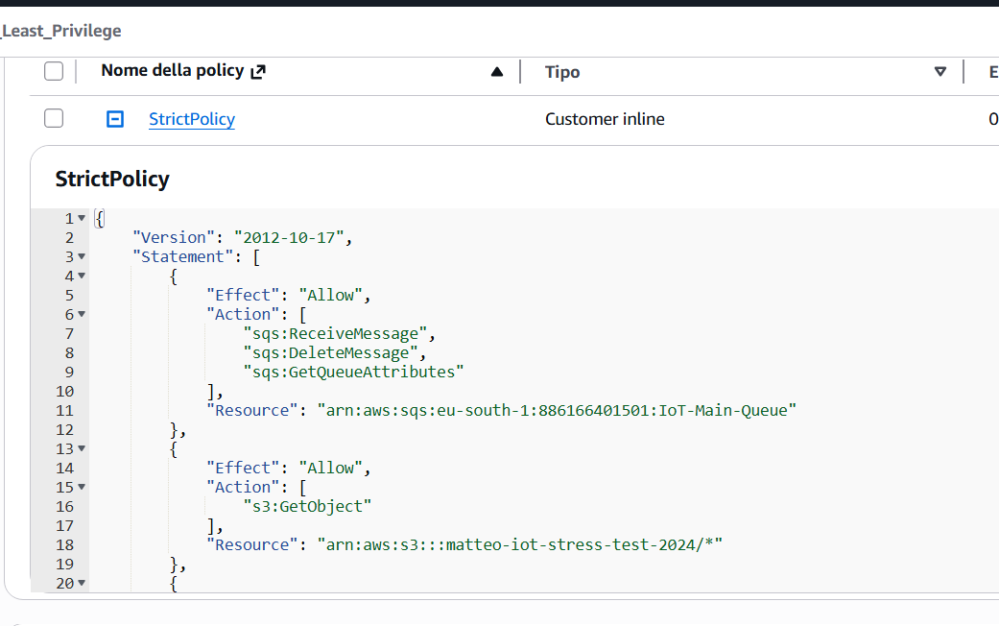
Security & The Least Privilege Principle
Abandoning AWS Managed Policies for strict, custom inline JSON rules.
Lambda Execution Role: Explicitly restricted using specific Resource ARNs.
Only allowed to ReceiveMessage from IoT-Main-Queue.
Only allowed to GetObject from the specific testing bucket.
Only allowed to PutItem to the IoT_Telemetry table.

Slide 7
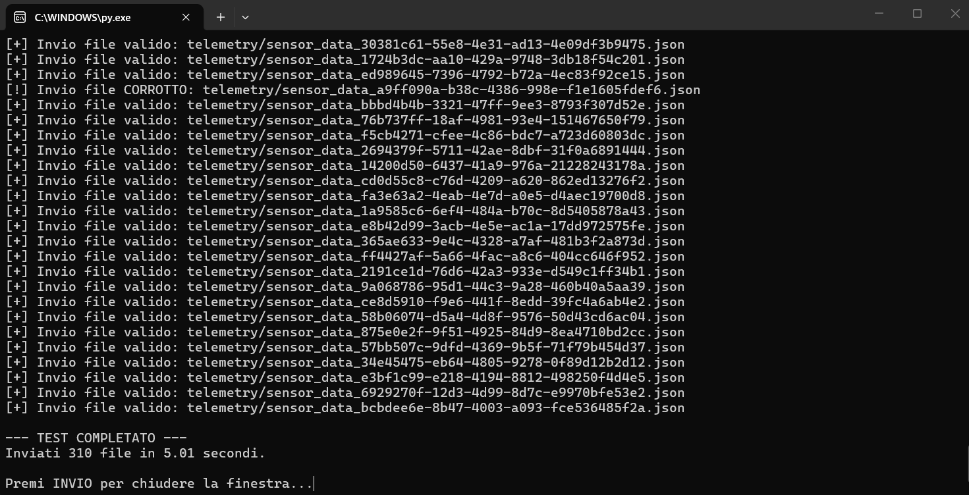
Massive Load Simulation (Stress Test)
Initial State: System at rest (Clean S3, empty queues, empty DB).
Action: A local Python script injects a massive sudden load.
Payload: 300 valid JSON files and 10 intentionally corrupted files sent concurrently via ThreadPoolExecutor.

Slide 8
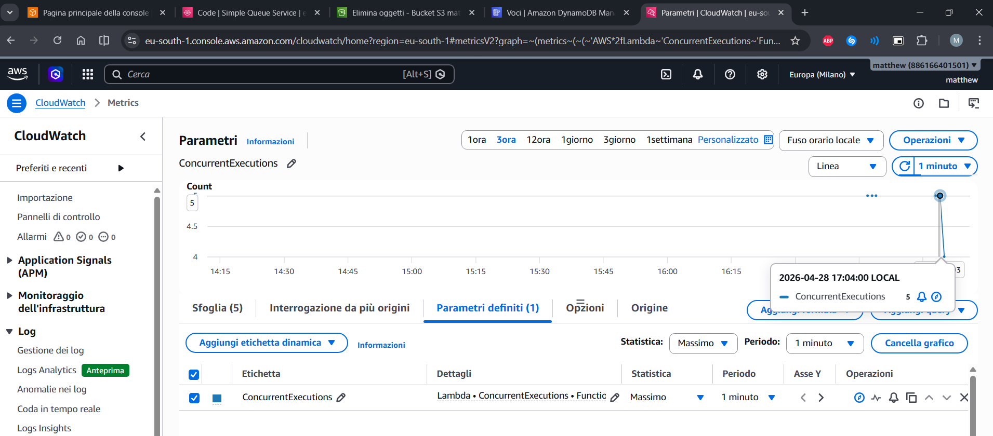
Controlled Rapid Elasticity
Demonstrating true Cloud Governance by limiting default behaviors.
Configuration: The SQS-Lambda trigger is strictly limited to a Maximum Concurrency of 5 and a Batch Size of 1.
Result: Even with hundreds of simultaneous uploads, exactly 5 containers process the workload, absorbing the spike smoothly.

Slide 9
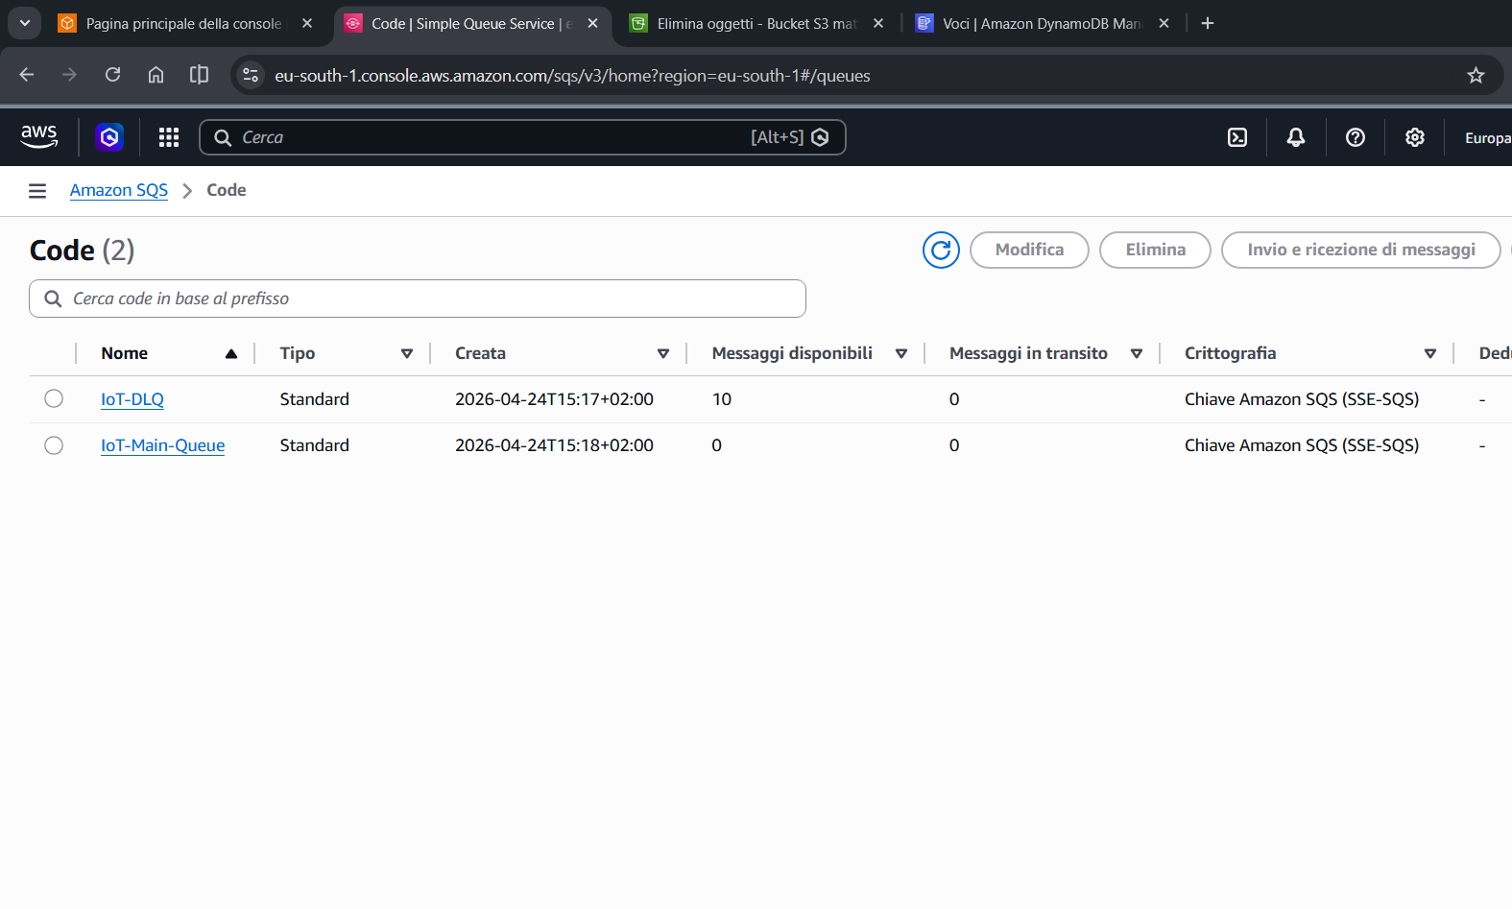
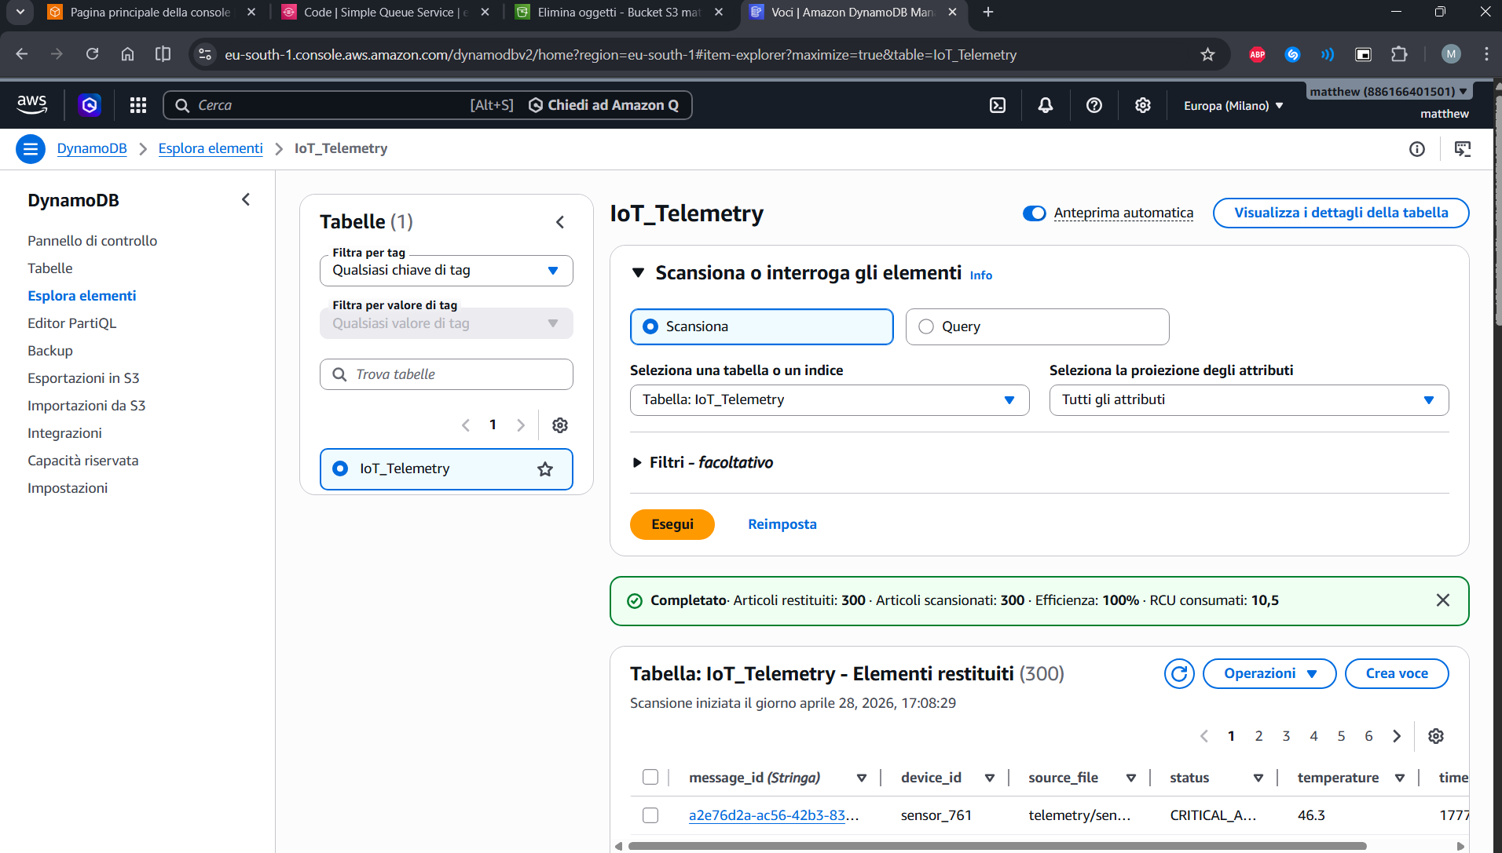
Fault Tolerance (DLQ) & Persistence
Persistence: The 300 valid files were perfectly processed and classified in DynamoDB.
Fault Tolerance: Lambda crashed on the 10 corrupted files. After 2 retries, SQS automatically routed them to the IoT-DLQ.
Result: Zero data loss and prevention of total pipeline failure.

Slide 10
Conclusions
True Decoupling Achieved: Storage, Compute, and Database scale independently.
Enterprise Readiness: Moving beyond default settings proved necessary to achieve real fault tolerance (DLQ) and protect downstream systems (Concurrency Limits).
Cloudonomics Validated: Costs remain strictly optimized without needing permanently provisioned servers

